Slide 1
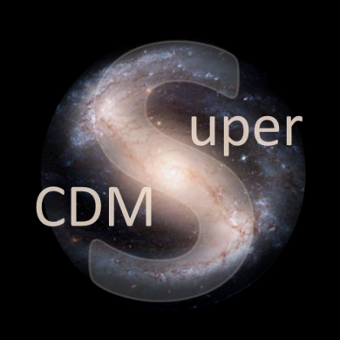


DM search with CUTE/SuperCDMS low background facilities
Serge Nagorny
on behalf of the CUTE collaboration
May 8th, 2019

Slide 2
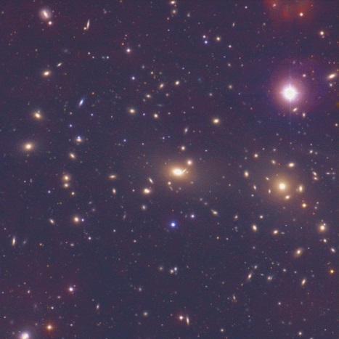
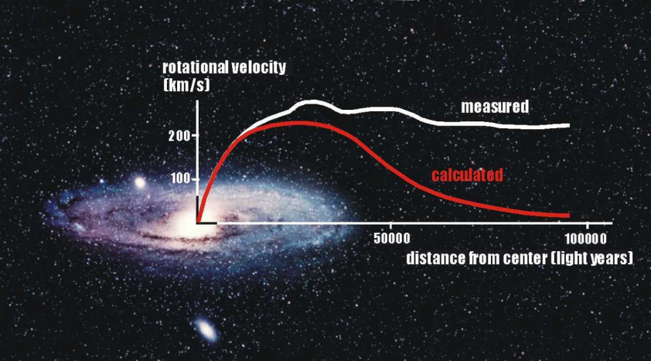
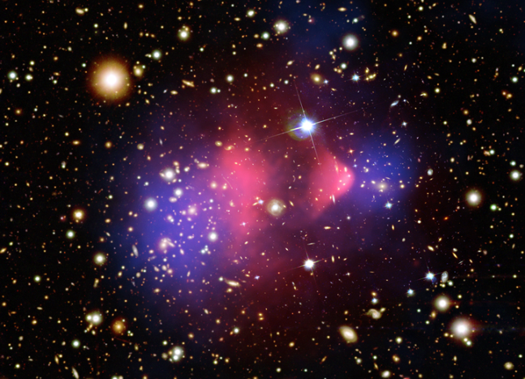
Dark matter evidence
Credit: O. Lopez-Cruz
I. K. Shelton
Credit: cdms.phy.queensu.ca
Credit: NASA, CXC, Cfa, et al.
Astronomical and cosmological observations suggest that
dark matter composes about 25%
of all matter in the universe

Slide 3
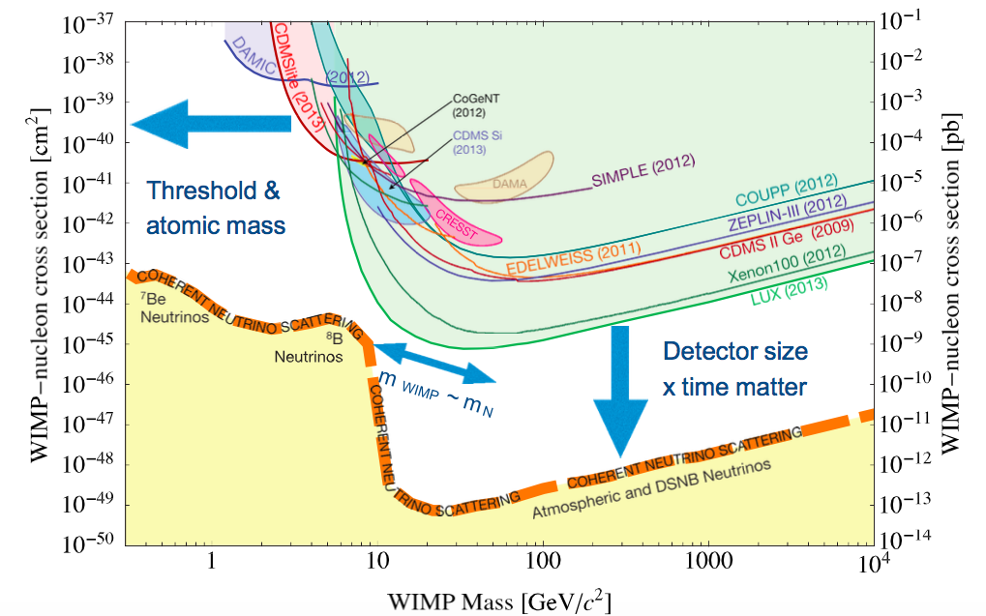
Brief reminder of situation in DM search
J Masbou EDU2017

Slide 4
Direct dark matter search
IONIZATION
DAMIC, SENSEI,
NEWS-G, DRIFT, MIMac
LUX
XENON
DarkSide
PandaX
EDELWEISS
SuperCDMS
SCINTILLATION
HEAT/PHONONS
PICO
WIMP
DAMA, SABRE, DEAP,
COSINE, MiniCLEAN,
XMASS
CRESST
COSINUS

Slide 5
Direct dark matter search
IONIZATION
SuperCDMS
HEAT/PHONONS
WIMP
Two channels approach
allows significant improvement
of experimental sensitivity !
WIMP (~ 200 km/s) interacts by elastic scattering on nuclei
Nuclear recoil <E> 1–100 keV
Exponential distribution
Low rate 1⋅10⁻⁴ evt/kg/d

Slide 6
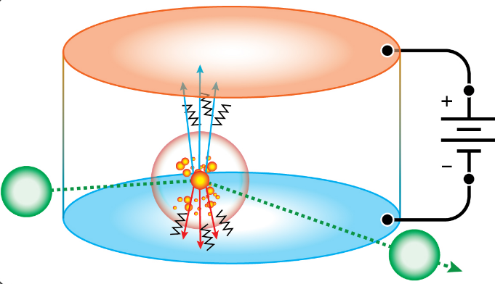
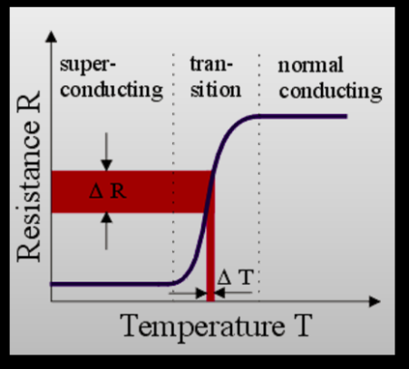
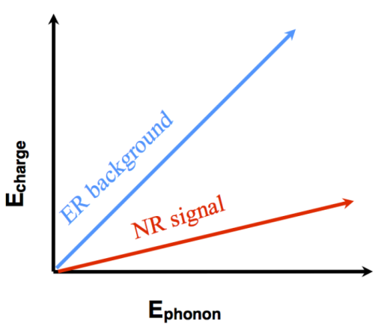
Concept of
ionisation-phonon detector
Cryogenic semiconductor detectors are operated at 10-30 mK to measure energy depositions
Signal ∝ ΔT = E_{o} / C_{T}
C_{T} = γT + AT³
Transition edge sensors (TESs) measure thermal energy in the form of phonons
Charge is collected on electrodes on surfaces and amplified with sensitive charge amplifiers
Measuring both phonons and charge signals allows for discrimination between electron and nuclear recoils

Slide 7
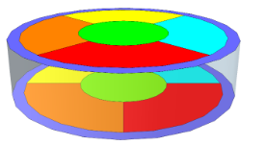
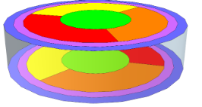
SuperCDMS detectors
iZIP detectors
Two channels (charge & phonons) allowing for particles discrimination (nuclear or electron recoils)
Can reject events that occur near the surface
Low energy threshold due to the Luke amplification of phonon signals on drifting charges
One channel (phonons)
NO particle discrimination
NO sensitivity to surface events
HV detectors

Slide 8
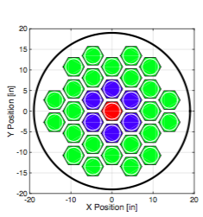
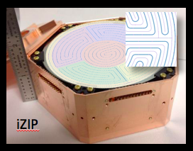
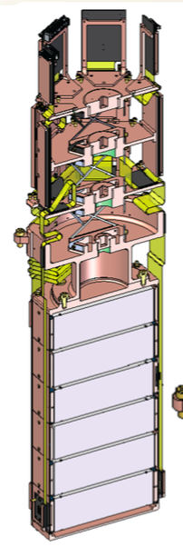
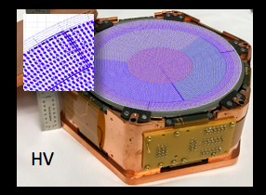
SuperCDMS detectors
Each detector of about
1 kg Ge/Si
6 detectors
in tower
Phase 1: 4-7 towers in cryostat
Final goal: 31 towers

Slide 9
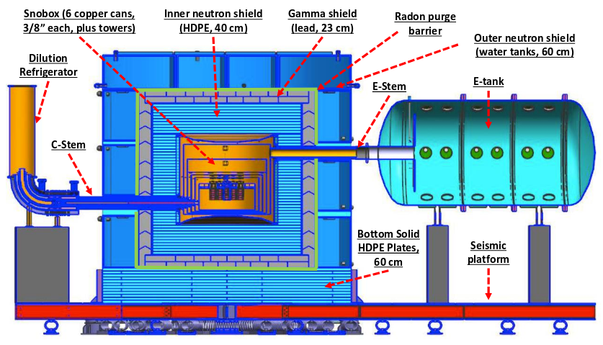
SuperCDMS setup (construction 2019-2020)
arXiv: 1610.00006

Slide 10
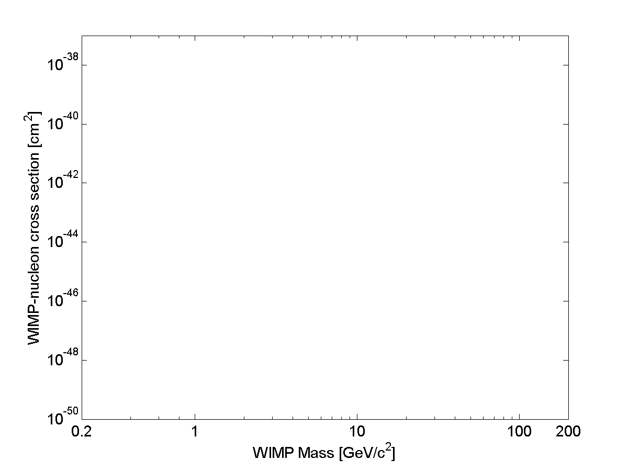
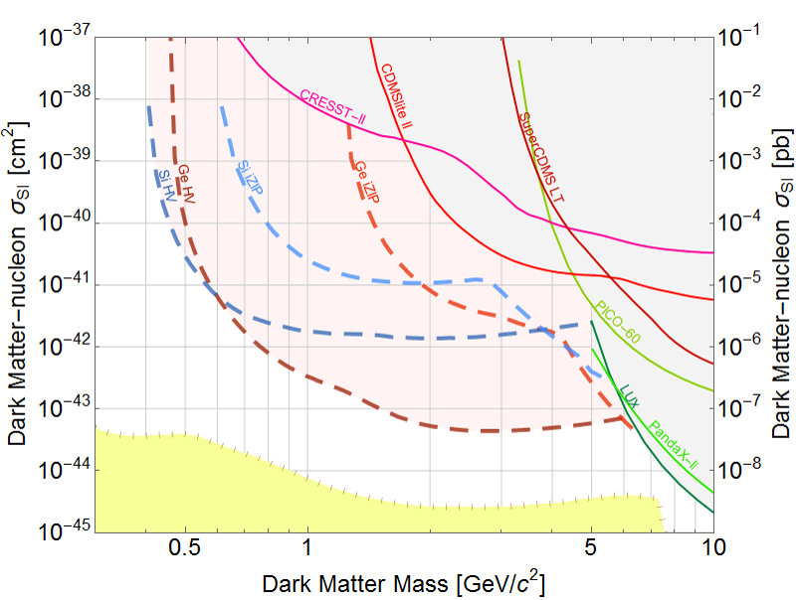
SuperCDMS expected sensitivity @ SNOLAB
CRESST
2015
DAMIC 2016
Si iZIP
Ge iZIP
CDMSlite
2015
DAMA
Si HV
CDMS Si
Ge HV
DAMA
“iZIP” detectors
Higher threshold
Part.ID.
SuperCDMS LT 2014
CDMS II 2015
LUX 2013
Solar Neutrinos
DEAP
XENON1T 2017
LZ
Longterm goal
Atmospheric Neutrinos
“HV” detectors
Low threshold
No Part.ID.
arXiv:1610.00006

Slide 11
Motivation for CUTE facility
Provide a moderate size (10 kg detector) handy (few days turnover) well-shielded cryogenics (20 mK) infrastructure for rare event physics
Test and validation of entire SuperCDMS detector tower (6 detector + electronics)
Measurements in a low background environment avoiding cosmogenic activation of detector’s material (³H, ³²Si, etc.)
Complete SuperCDMS detector characterization to understand its intrinsic background and noise issues
Confirmation of screening program and handling procedures
Early science run for dark matter search can be performed thanks to low-background environment and low-energy threshold of SuperCDMS detectors
Testing of various type cryogenic detectors

Slide 12
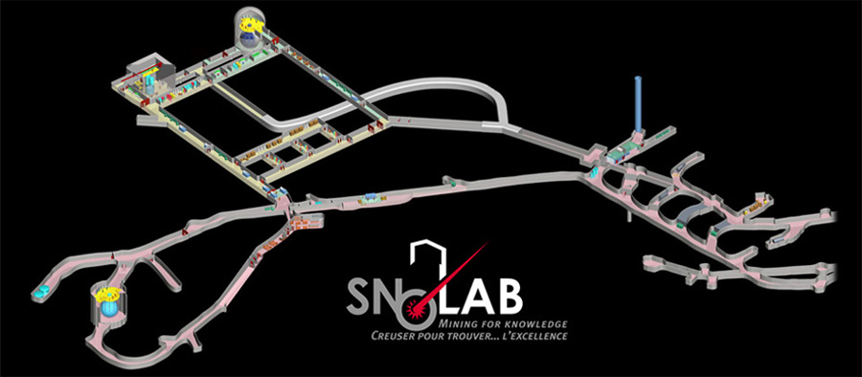
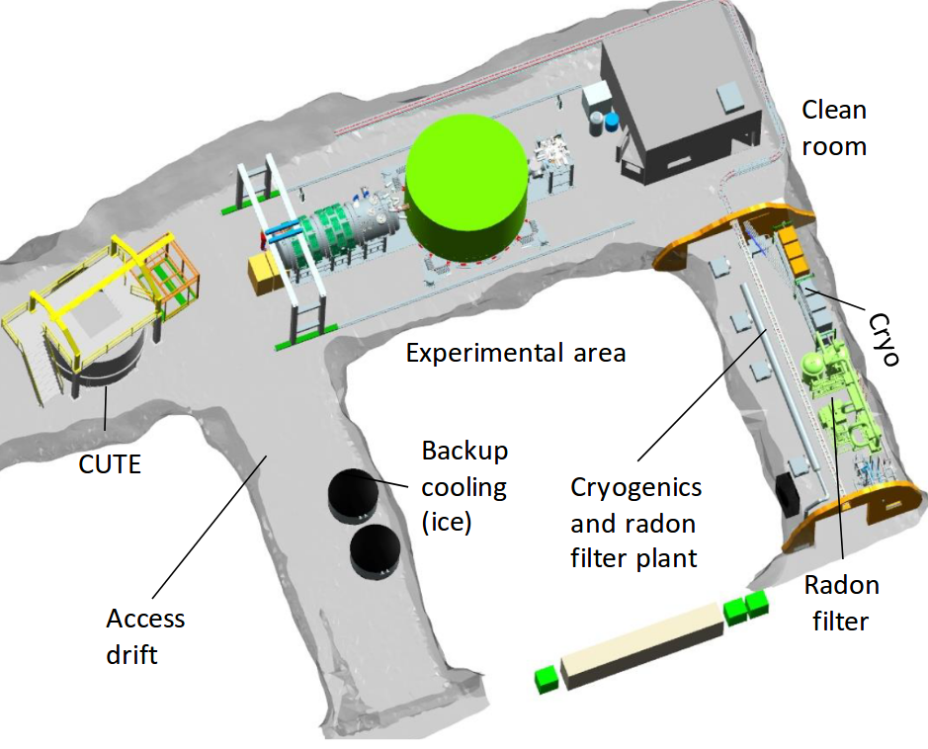
SuperCDMS and CUTE at SNOLAB
SuperCDMS
2 km deep
Strong cosmic ray flux
suppression
Cleanroom environment
Rn-free air plant

Slide 13
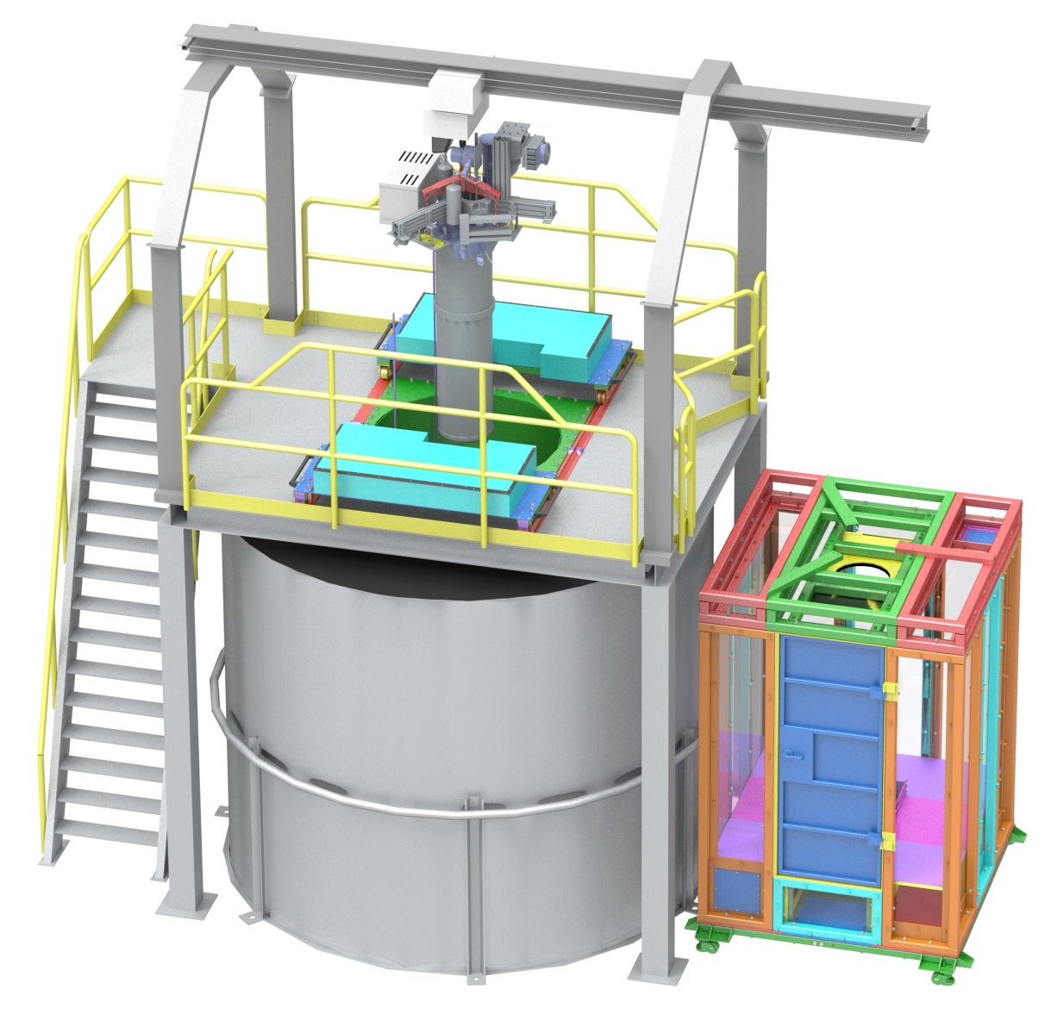
General view of the CUTE facility
Monorail with
1000 kg hoist
Cryostat
Drywell with
Pb shield/
Mu-metal
Platform
Cleanroom
Movable
HDPE shield
UP water
shield tank

Slide 14
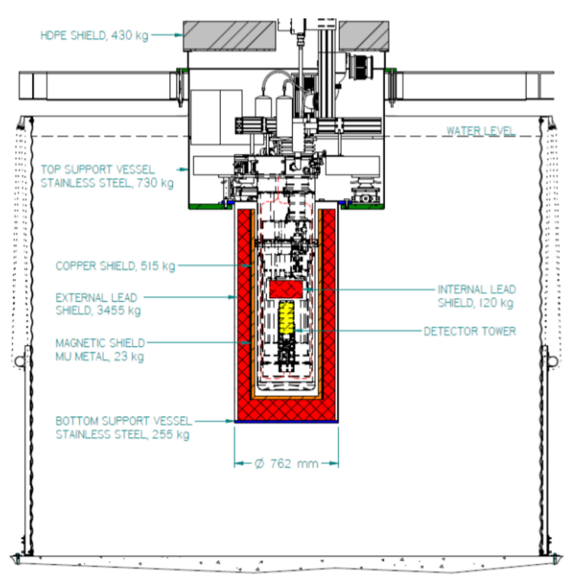
Shielding in the CUTE facility
Cryostat placed inside the drywell of a water tank
1.5 m of water layer at side and 1.0 m at bottom reduces external neutron and gamma flux
11-15 cm of low activity Pb reduces residual gammas
The gap from the top is closed off by 20 cm of HDPE and 15 cm of Pb inside cryostat
Internal Cu shields block IR photons, which contribute to detector noise

Slide 15
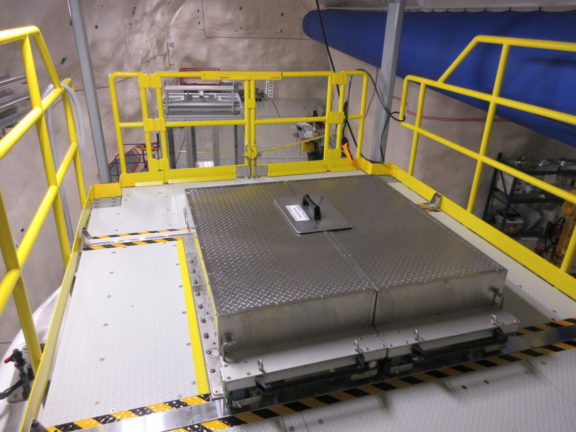
PE shielding
Installed
Fully functional, tested during Pb shield installation, Jan 2019

Slide 16
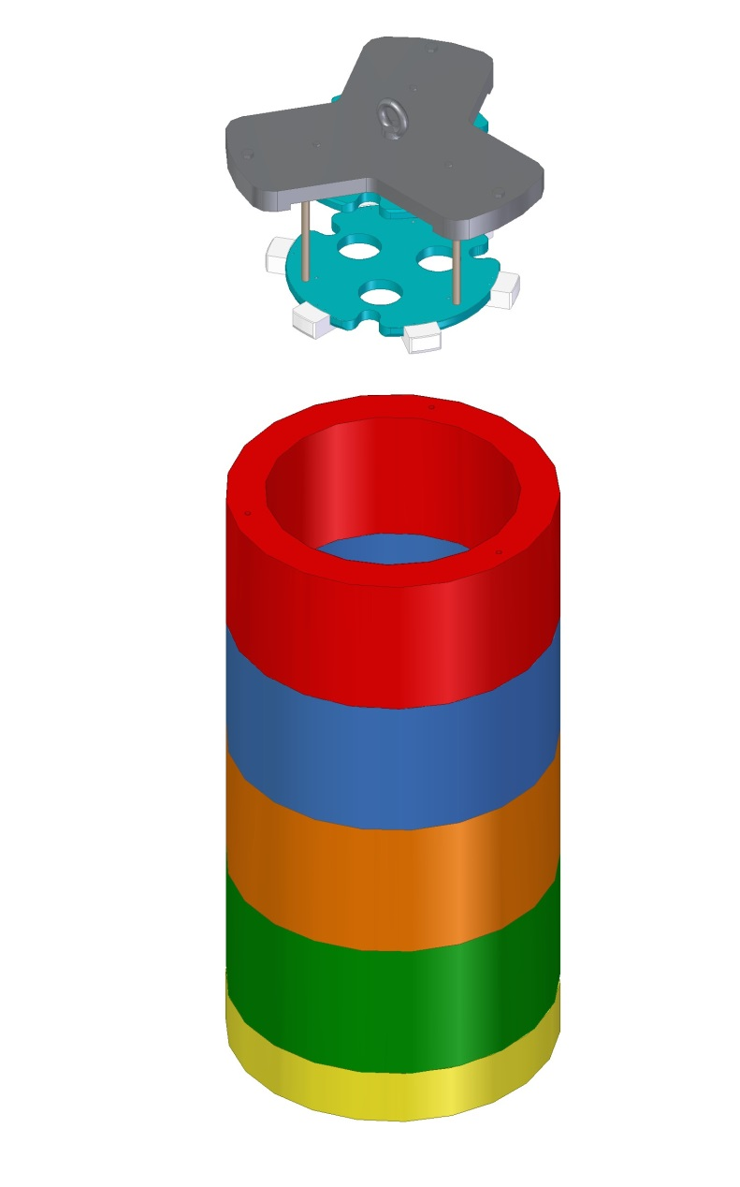
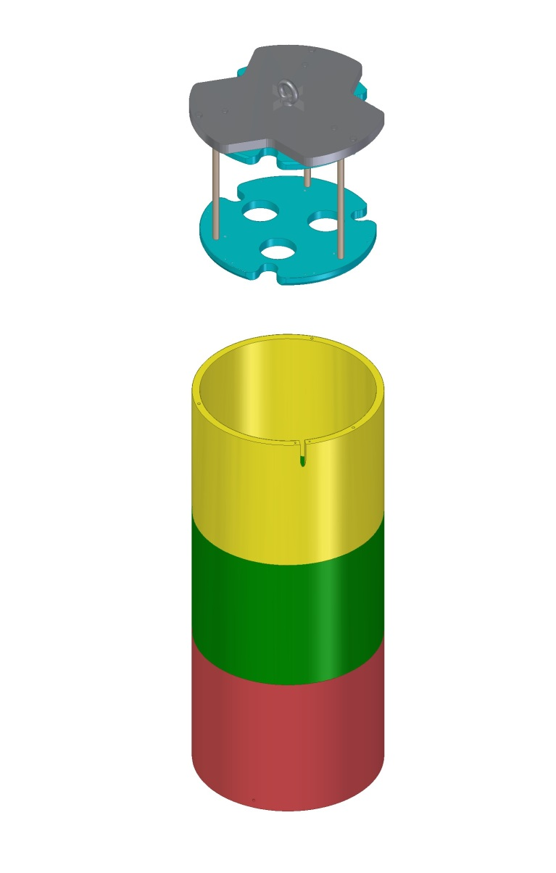
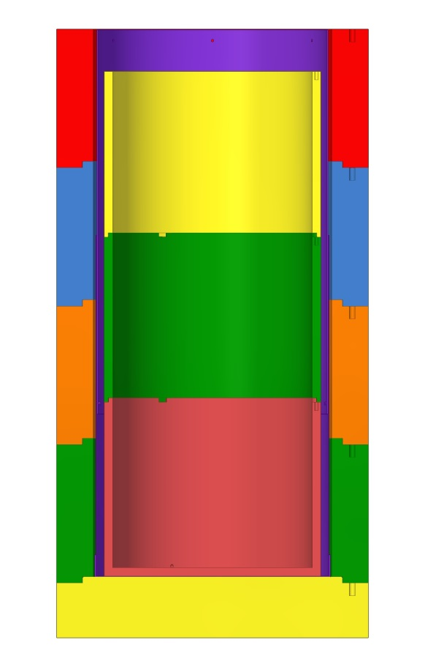
Lead shielding
9 cm
outer layer
650 kg
140 kg
2 cm
inner layer
13 cm
outer layer
Pb inner layer
< 3 Bq/kg
Pb outer layer
< 30 Bq/kg

Slide 17
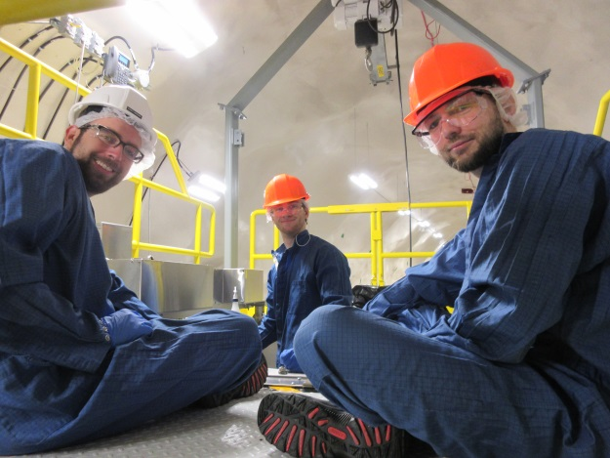
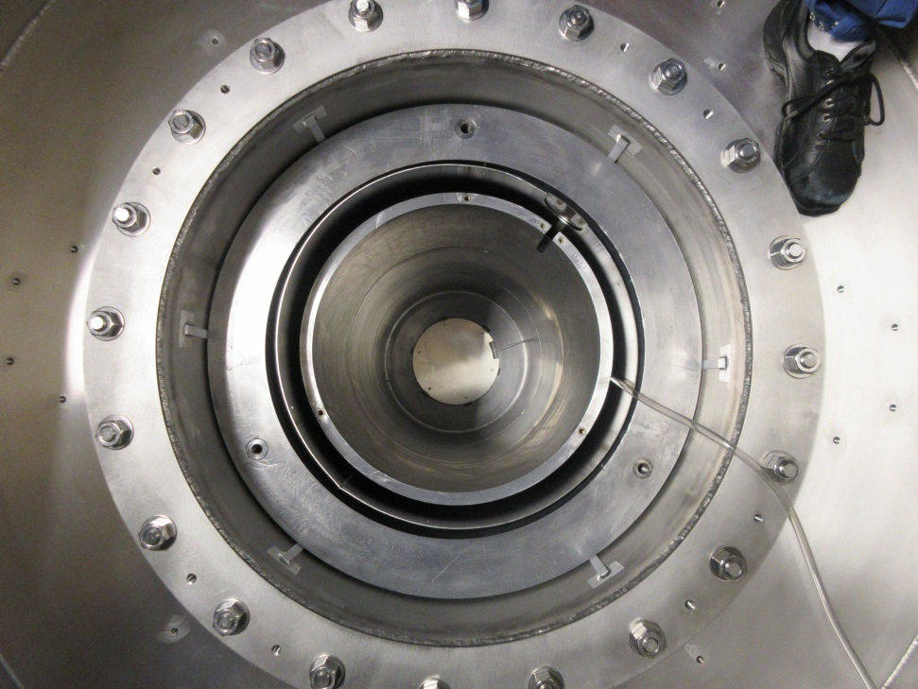
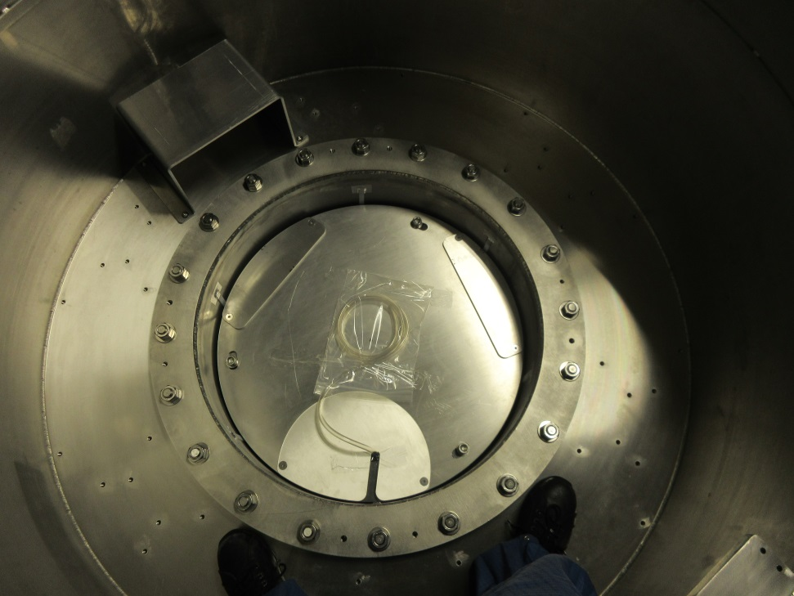
Lead shielding
Installed @ Jan 25th, 2019
Drywell
Serge
Service step
Lead cover plate
Inner Pb, 2 cm
< 3 Bq/kg
Outer Pb, 9 cm
< 30 Bq/kg
Gas purge system
Mu-metal

Slide 18
Cleanroom (Class 500)
to minimize dust and radon exposure of detectors during mounting/dismounting procedures
Acceptable exposure < 80 Bq⋅h/m³
SuperCDMS detector tower will be delivered to SNOLAB in container under N₂ atmosphere and must be opened and installed in cryostat at CUTE cleanroom
Air @ SNOLAB | Underground | Surface
Rn activity | 100-130 Bq/m³ | < 10 Bq/m³
Handling time | 30-40 minutes | 8 hours
our goal

Slide 19
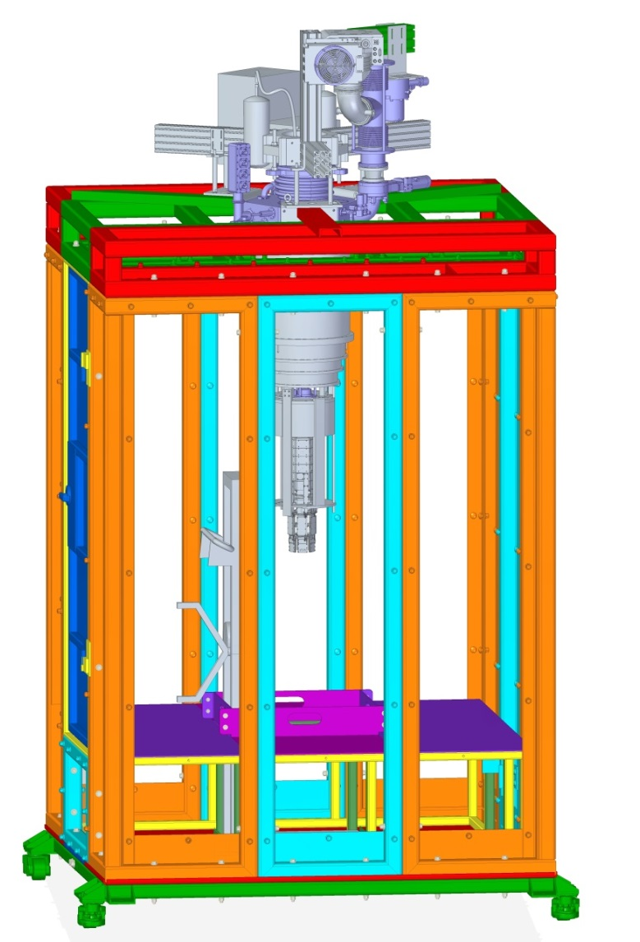
Cleanroom
Space for two operators
Aluminum structure with LEXAN panels
Resistant to seismic events
Movable
Lifting device for cryostat cans
Low Rn air supply (< 3 Bq/m³)
Later SuperCDMS Rn-filter system (< 0.1 Bq/m³) will be used
Crane moves cryostat between cleanroom and drywell

Slide 20
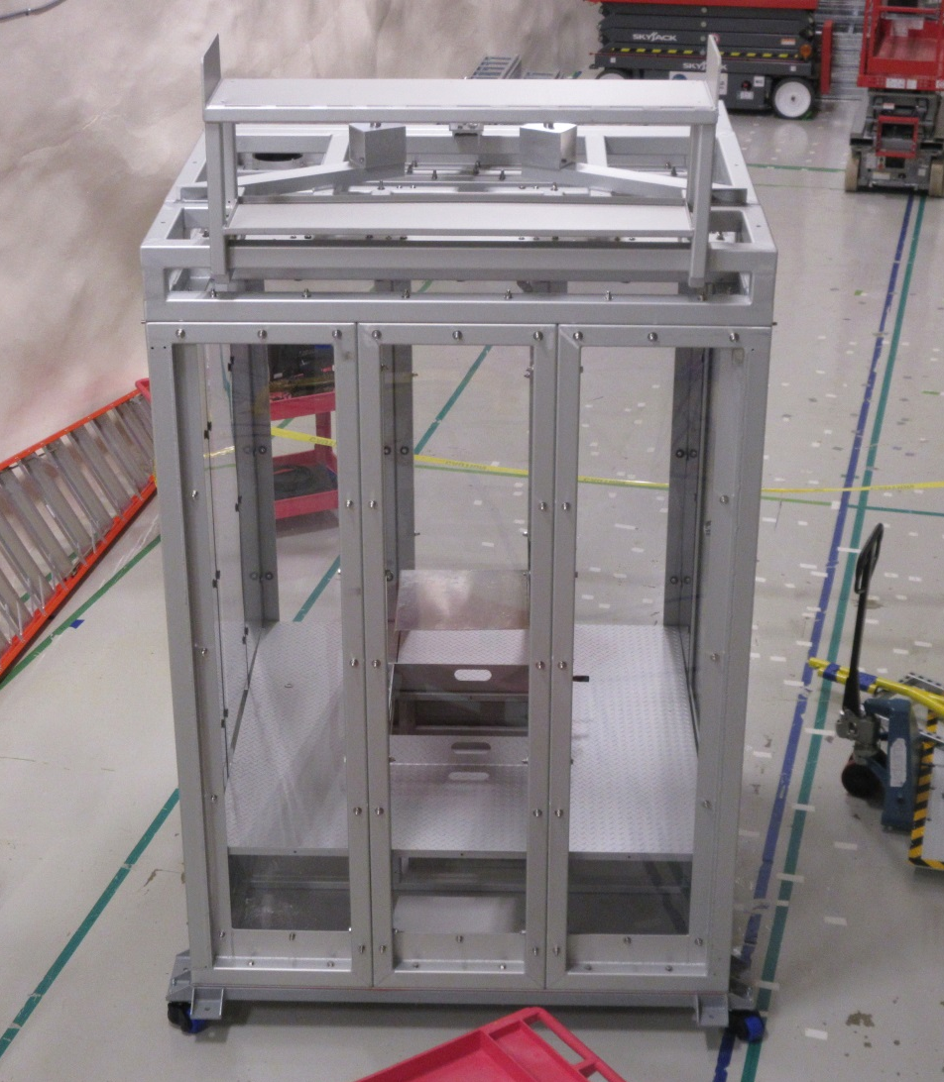
Cleanroom status
95% installation accomplishment
To be completed:
Connection to compressed air line
HEPA filter installation
Will be completed within last week of May, 2019

Slide 21
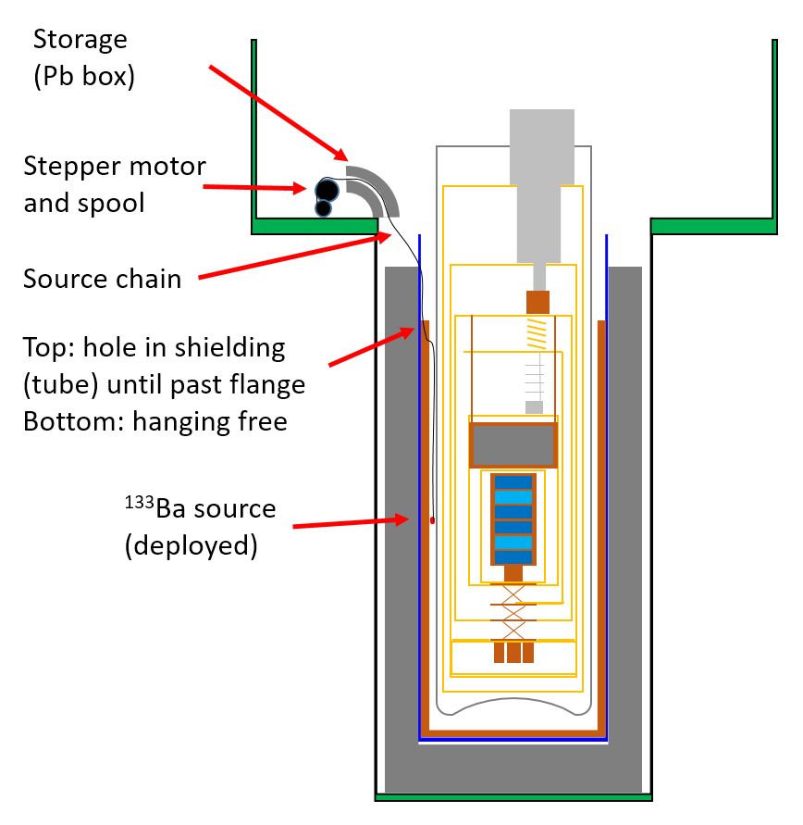
Calibration system concept
Different radioactive sources will be used to calibrate the energy scale and to monitor stability of detectors performance, as well for characterization of particle interaction types
Gamma source: ¹³³Ba (this Installation stage)
Neutrons source: ²⁵²Cf (next step in a while)
Sources will be remotely moved from shielded storage box to the measurement position

Slide 22
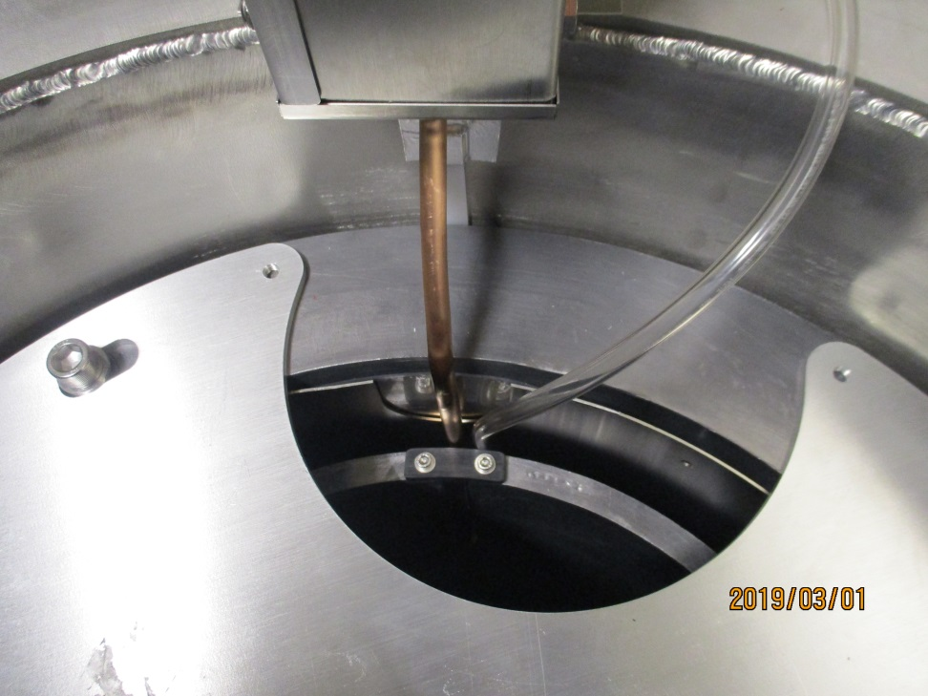
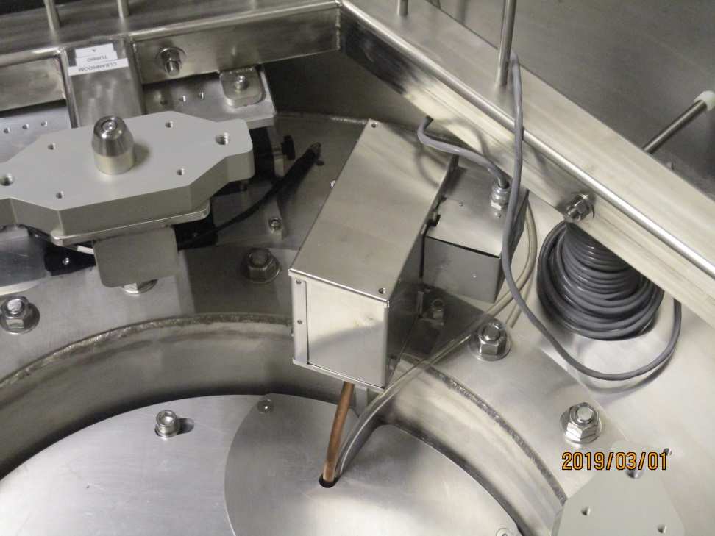
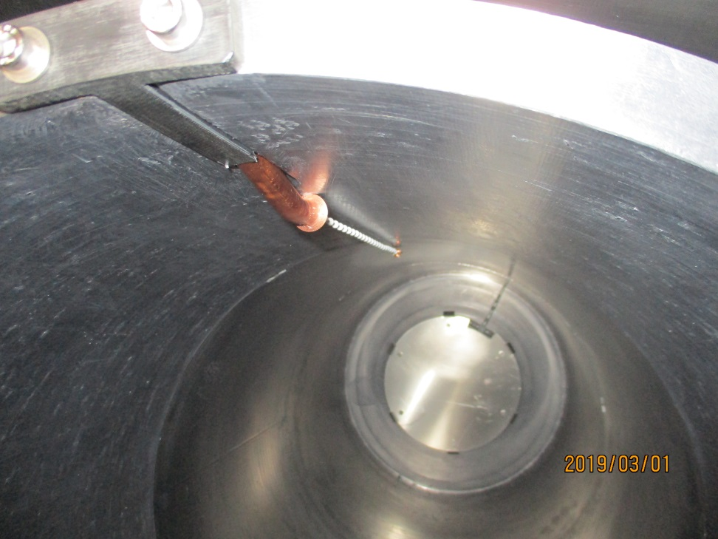
Calibration system status @ March 1st, 2019
Guiding tube
¹³³Ba source
Plastic chain

Slide 23
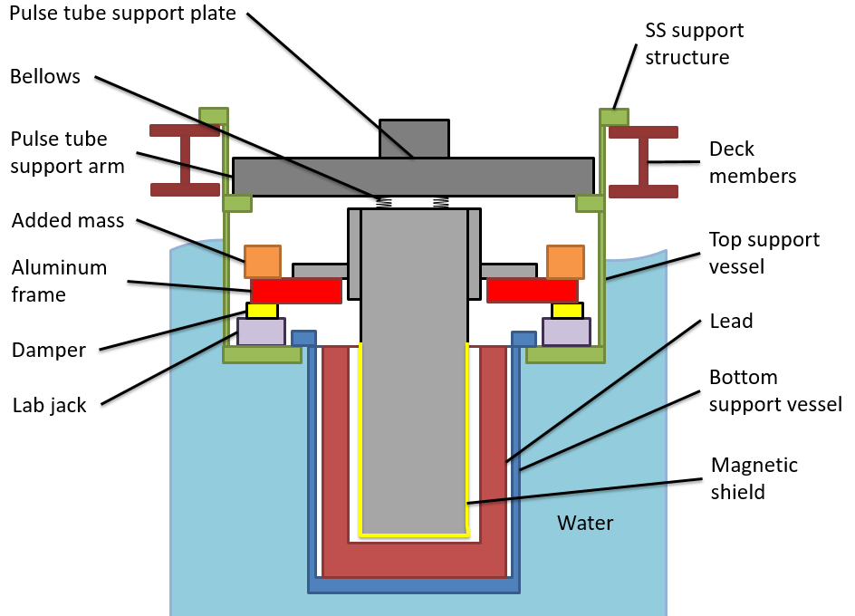
Active two-stages suspension system
Pulse tube & turbo pump
Our detectors are sensitive to mechanical vibrations
Pulse tube cooler and turbo pump are strong source of vibrations that may compromize detector performance
Both are mounted on separate plate with soft coupling (bellows) to cryostat to minimize vibrations
The bellows makes system sensitive to pressure fluctuations in SNOLAB
Active suspension system tracks/controls cryostat position better than 1 mm
SS frame
Mechanical parts of the Suspension system

Slide 24
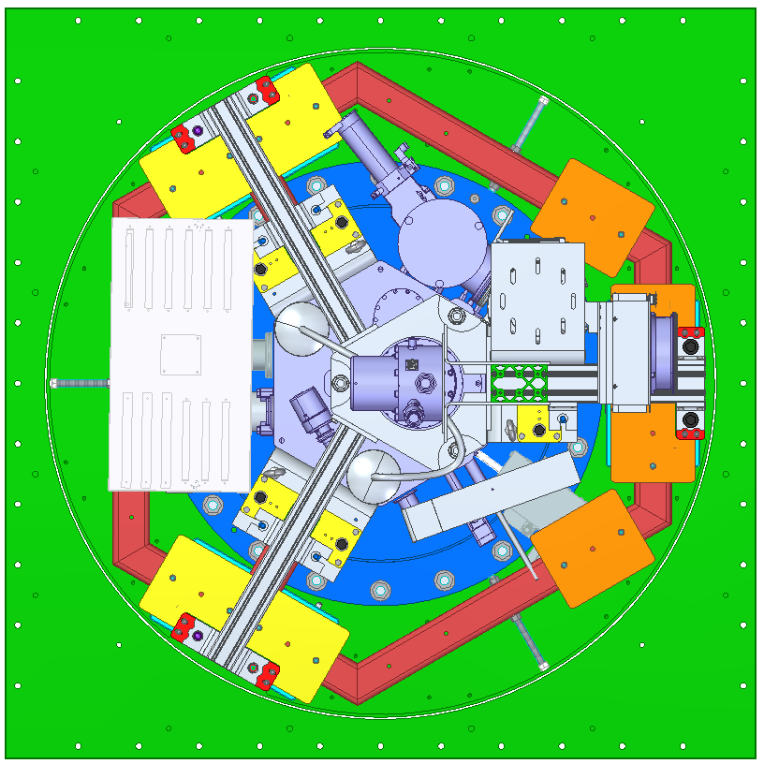
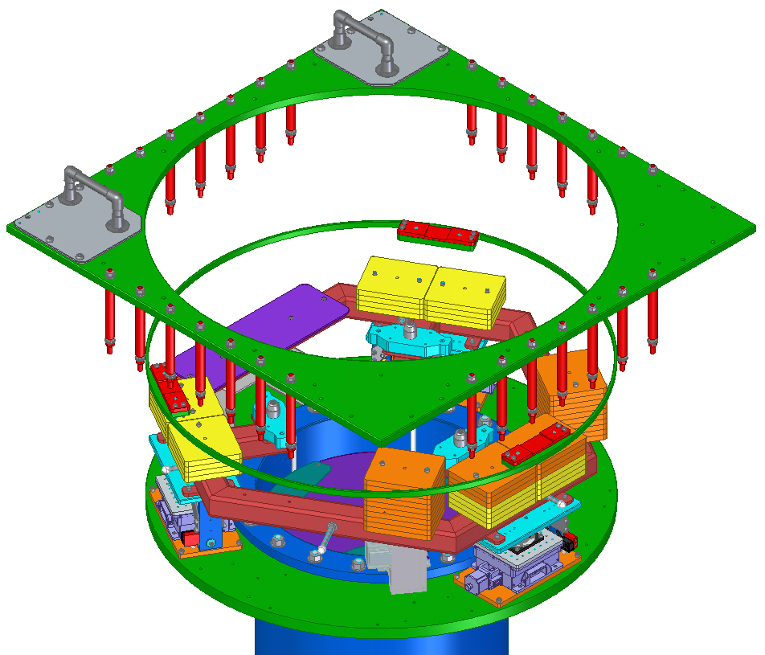
Suspension system assembly
electronics box
pulse tube
turbo pump
drywell
supporting frame
added masses
(about 400 kg in total)
damper

Slide 25
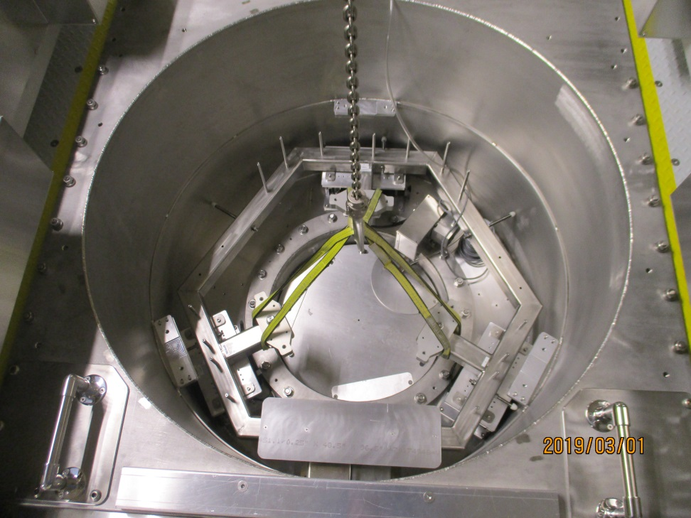
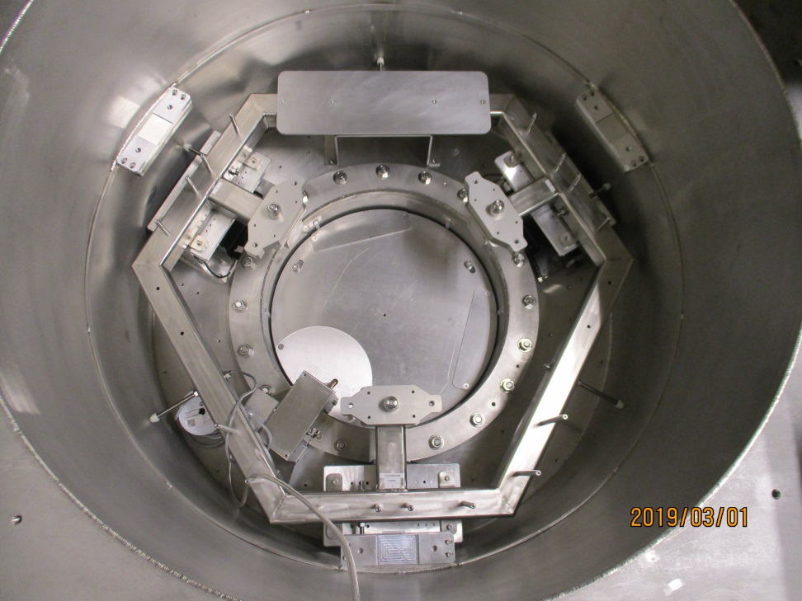
Suspension system assembly
installed at March 1st, 2019
Lowering suspension frame into drywell
Suspension frame is installed
Lab jacks
Cryostat
alignment pins
Service handles & step
Calibration
system

Slide 26
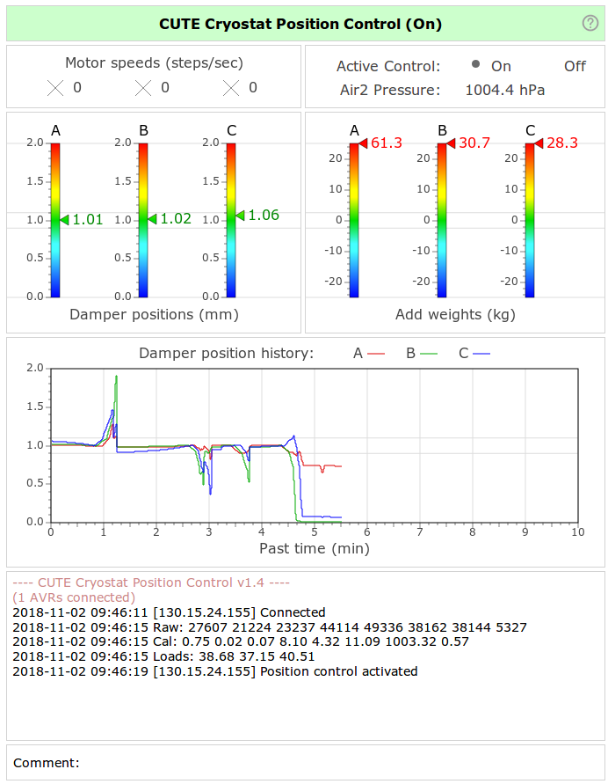
Remote control of suspension system
Tracks environmental condition (pressure, water level, noise level)
Records of all system parameters into database
Provides possibility to off-line analysis of behavior

Slide 27
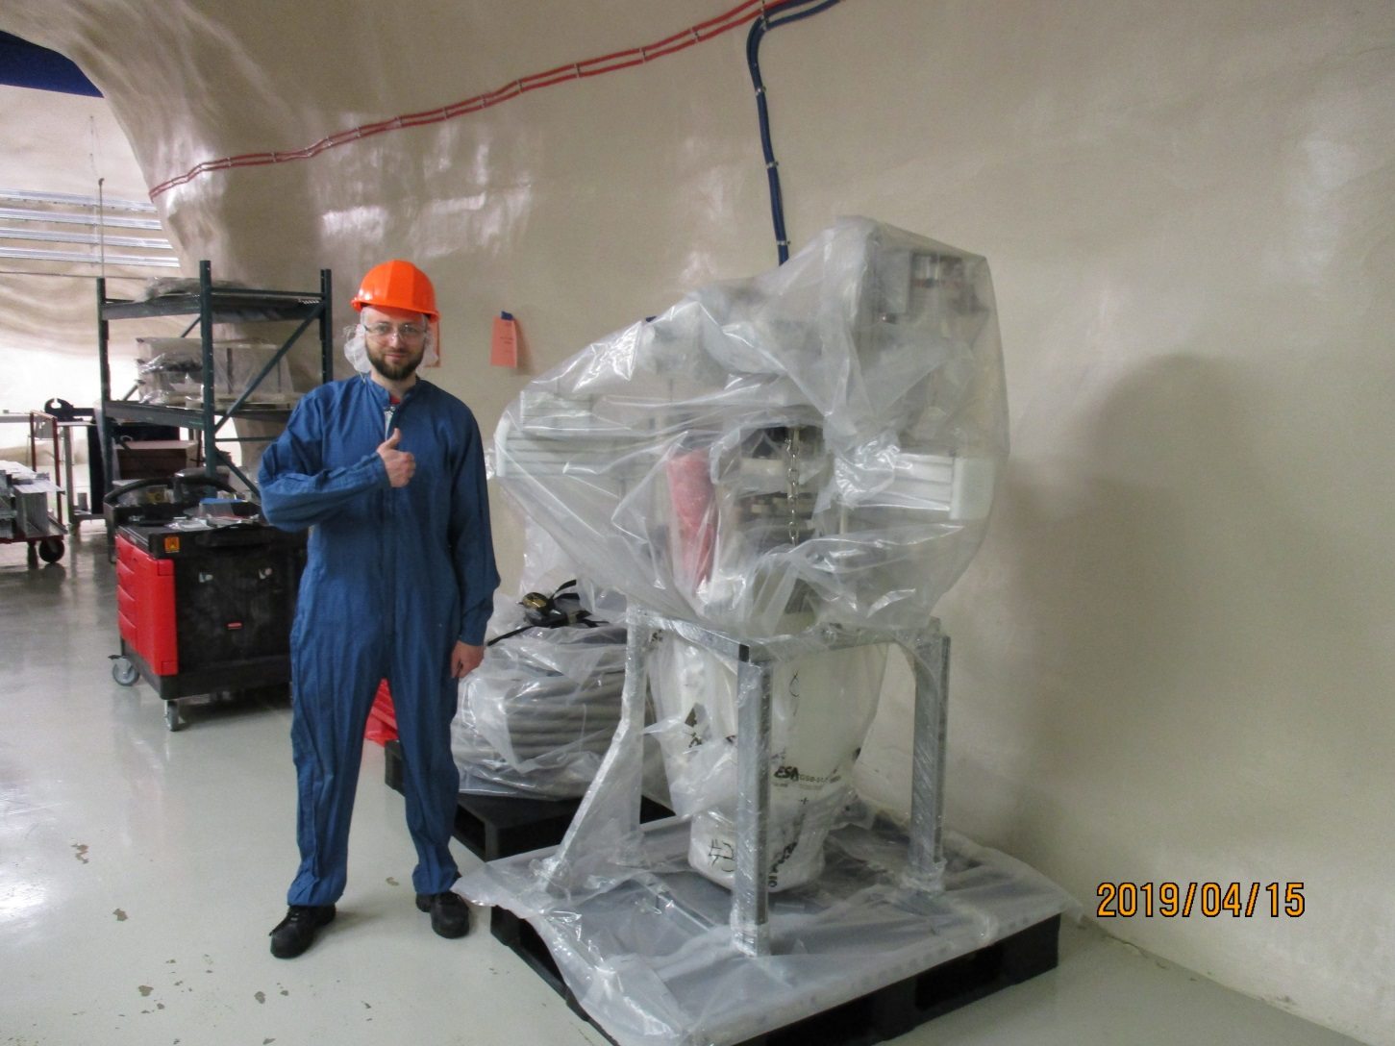
Cryostat delivery to SNOLAB underground site
Ready to the first mechanical test in cleanroom/dry-well

Slide 28
Payload for CUTE
Commissioning
Task | Time Period
Testing of CUTE facility at SNOLAB Without detectors With detectors (G124) Revision/fixing problems/commissioning | May 2019 – June 2019
Testing SuperCDMS detectors Si HV Pathfinder HVeV detector First tower (6 iZIP Ge Detector) | July 2019 – May 2020
Own R&D activity HVeV detector from enriched ²⁸Si Scintillating bolometers based on YVO₄, ZnSe, ^{arch}PbMoO₄ crystals Advanced light detectors | from Sept 2019
Early operation

Slide 29
Background budget in energy range 0-2 keV
Material | Estimated background, events/(keV⋅kg⋅day)
External background (lad walls, etc.) | 1.1
External Pb shielding | 0.7
Stainless steel vacuum can | 0.6
Internal background (cryostat cans, etc.) caused mostly by ²¹⁰Pb | 0.5
Cosmogenic activation (³H, etc.) | < 0.1 (SNOLAB) 0.5 (early detector)
³²Si (in silicon detectors) | 0.7
Detector housing | < 0.1
Total background for Ge SuperCDMS detectors in the CUTE facility
is estimated to be ≤ 3 events/(keV⋅kg⋅day)
and will be precisely evaluated in the first background runs at SNOLAB

Slide 30
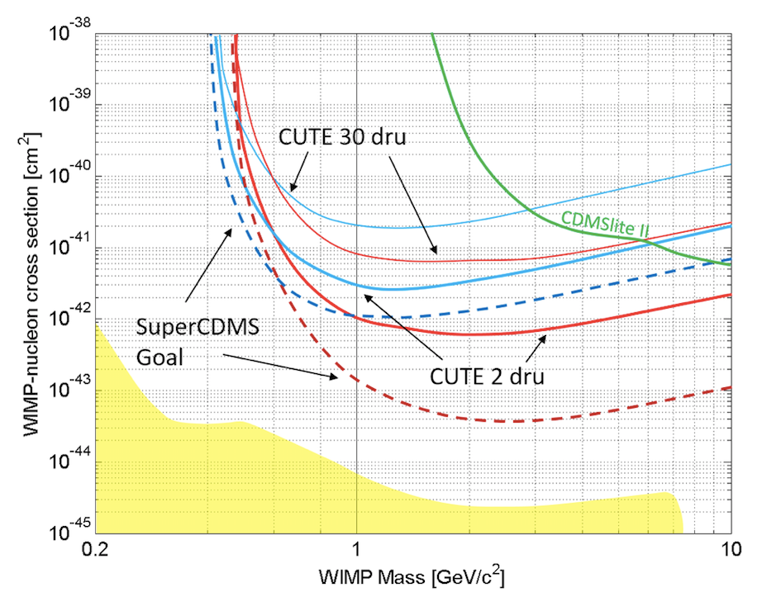
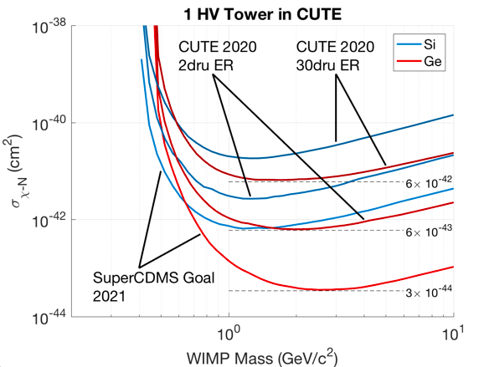
Early science at CUTE facility
One Tower of HV-type SuperCDMS (6 detectors) measured for 1 year

Slide 31
Explore the Universe with CUTE!

Slide 33
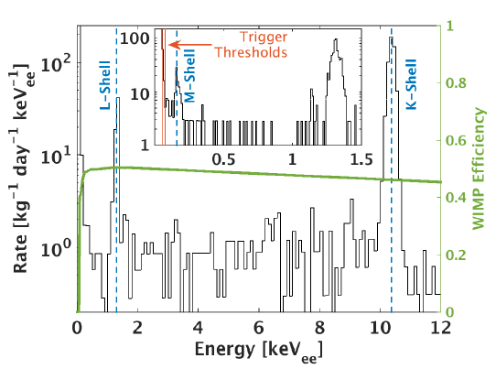
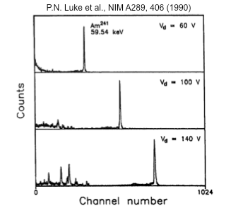
Luke-Neganov effect in CDMSLite -2: use phonons to read charge
Single detector : exposure 70 kg.d
Threshold : 75 eVee = 350 eVNR on Ge
Loss of background discrimination
BG diluted with respect to signal
Bias a standard SuperCDMS 600 g iZIP detector at 69 V (rather than 4 V)
Phonon amplification proportional to charge, bias voltage

Slide 34
Dark matter theories
arXiv: 1310.8642

Slide 36
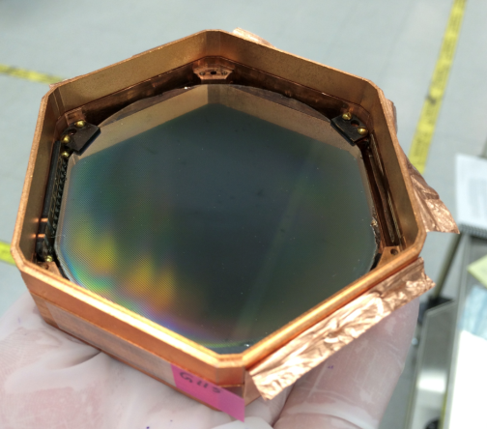
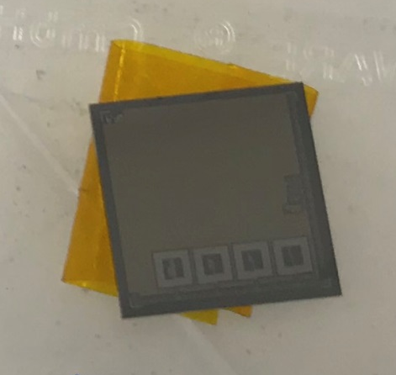
Test done @ Queen’s University
“G115”
∅ 76 × 10 mm
240 g
4 phonon channels
TES chip
10 × 10 × 1 mm
0.5 g
4 phonon channels
Bolometric performance/
External background
RF noise/Vibration

Slide 37
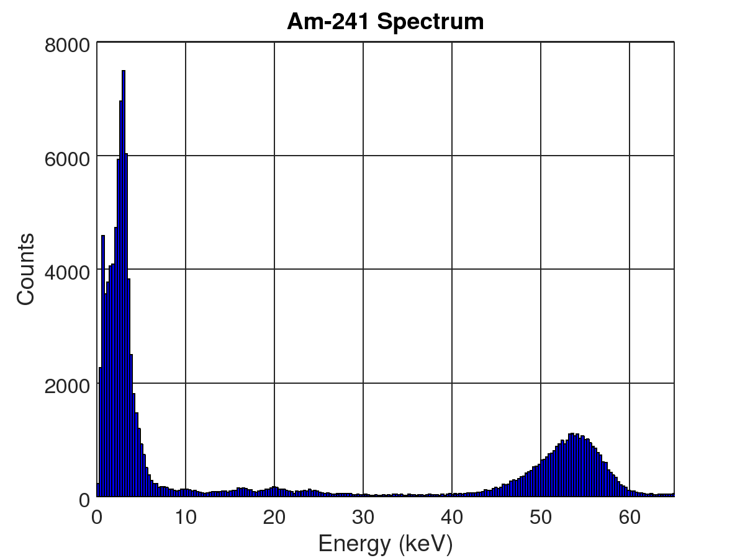
Test done @ Queen’s University
²⁴¹Am source
Low energy 17.7, 20.7, 26.3 keV X-rays show good energy resolution
59.5 keV line appears at a lower energy due to detector saturation effects
Low energy events are mostly noise induced trigger, improved analysis techniques should remove most of this
noise
²⁴¹Am
59.5 keV
²⁴¹Am
X-rays
E_{thr} = 5 keV
FWHM = 1 keV @ 17.7 keV

Slide 38
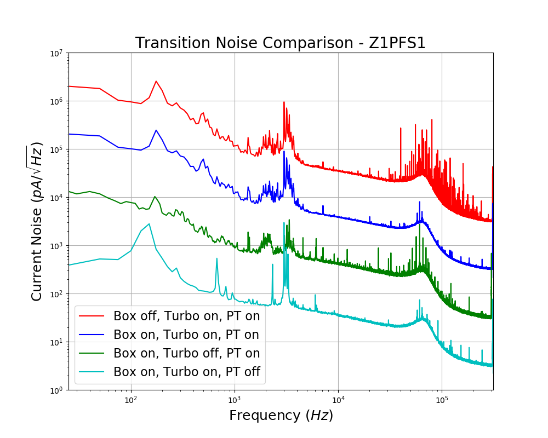
Test done @ Queen’s University
HF Noise
Before RF box
The noise of TES-chip was studied
while they were in the transition between normal and superconducting states, and in normal state
An aluminum box was placed around the read-out electronics, leading to an improvement in high frequency noise
The power supply for the read-out electronics that will be used at SNOLAB was also tested, and it lead to improved high frequency noise performance as well
Normal Noise: ~5 pA/√Hz
SC Noise: ~40 pA/√Hz

Slide 39
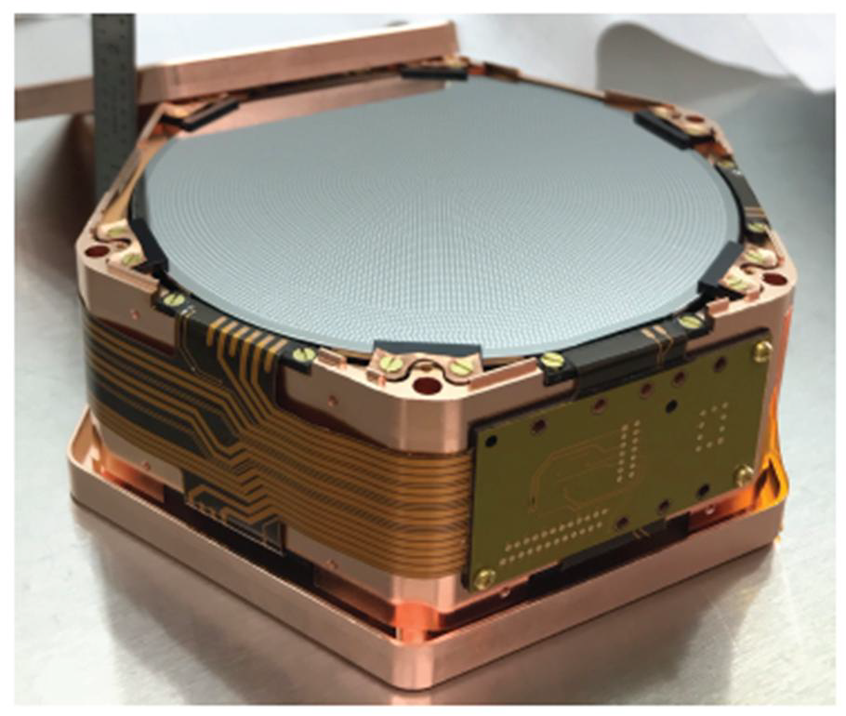

Expected detectors for Early Operation
Si HV Pathfinder Detector
Ge iZIP Prototype Detector
1 detector in Tower
6 detectors in Tower
July 2019 – August 2019
March 2020 – May 2020

Slide 40

Final arrangement
3/9/2016

Slide 41


PE shielding
20 cm thick HDPE layer on top of the cryostat for neutron flux suppression

Slide 42


PE shielding
8 layer of 1” HDPE sheet
Rigging/lifting test at producer site

Slide 43


Calibration source design (tested)

Slide 44




Calibration source encapsulation
in 1st layer
in 2nd layer
as-bought
Double layer encapsulated, ready to be assembled

Slide 45

Calibration system: general overview

Slide 46
Time-schedule
Date (week) | Task
Feb 4, 2019 | Prepare suspension frame for shipping
Feb 5th, 2019 | Installation Review Phase 2B
Feb 11, 2019 | Assemble, clean, and package of calibration system Ship suspension and calibration to SNOLAB Fix last cryostat deficiencies
Feb 18, 2019 | Clean and package cryostat Ship suspension system underground
Feb 25, 2019 | Install calibration and suspension systems
Mar 25, 2019 | Ship cryostat to SNOLAB and ship underground with CUTE staff presence
Apr 1, 2019 | Cryostat installation Preparation for Operational Readiness Review
May 2019 | Operational Readiness Review

Slide 47
CUTE tasks before Early Operation
Date | Step
May, 2019 | DAQ mounting, and implement DAQ architecture for underground/surface CUTE lab
May, 2019 | Preparation for Operational Readiness Review
June, 2019 | Cleanroom operation test - air quality test - operational test - working procedure improvement
July, 2019 | Test all procedures , its correction based on the results of first run without/with detectors
July, 2019 | Evaluation of required manpower for run preparation&running
end of 2019 | Radio-assay of materials used for CUTE facility production
end of 2019 | Completion of CUTE background model

